Slide 1
Updates
2026-08-07

Slide 2
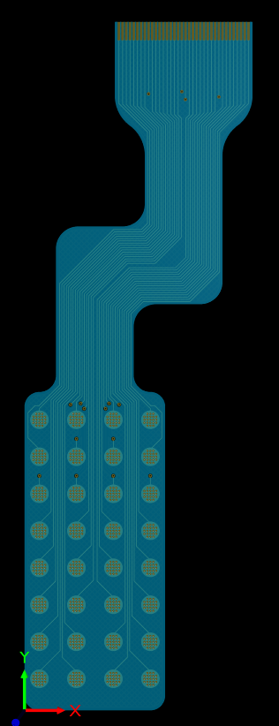
Electrode Patch #1

Slide 3
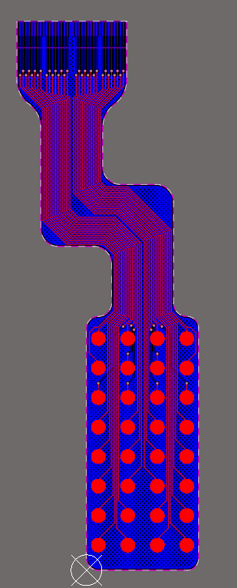
Electrode Patch #2

Slide 4
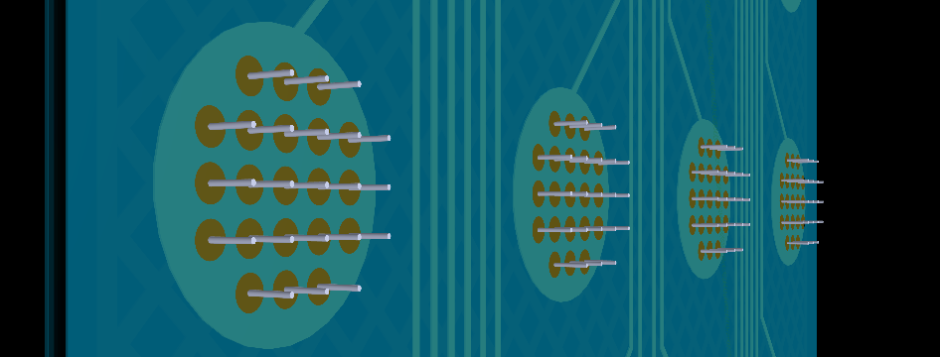
Microneedle View

Slide 5
Microneedle Electrode Patches
Reviews made by Kazim (Calgary University)
All good from his end
Compatible with his setup

Slide 6
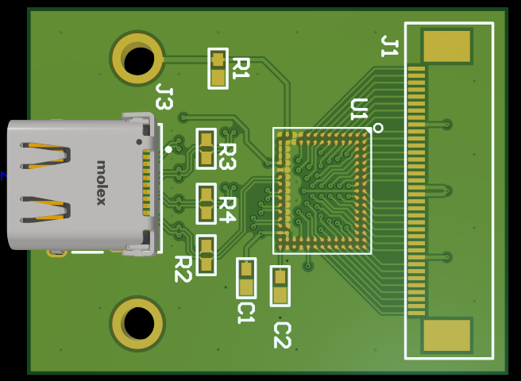
INTAN Electrode to USB

Slide 7
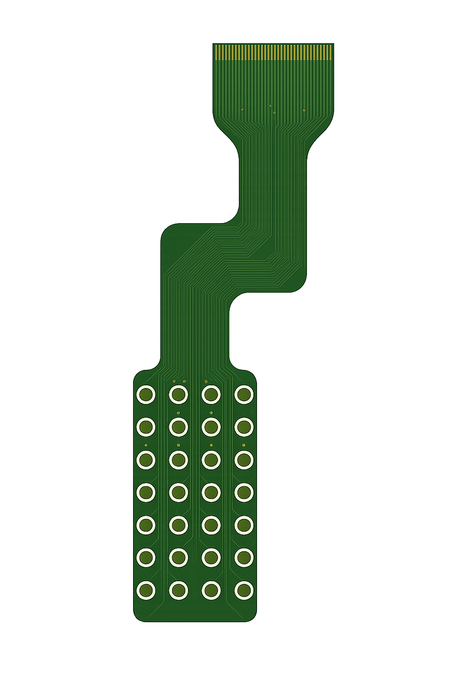
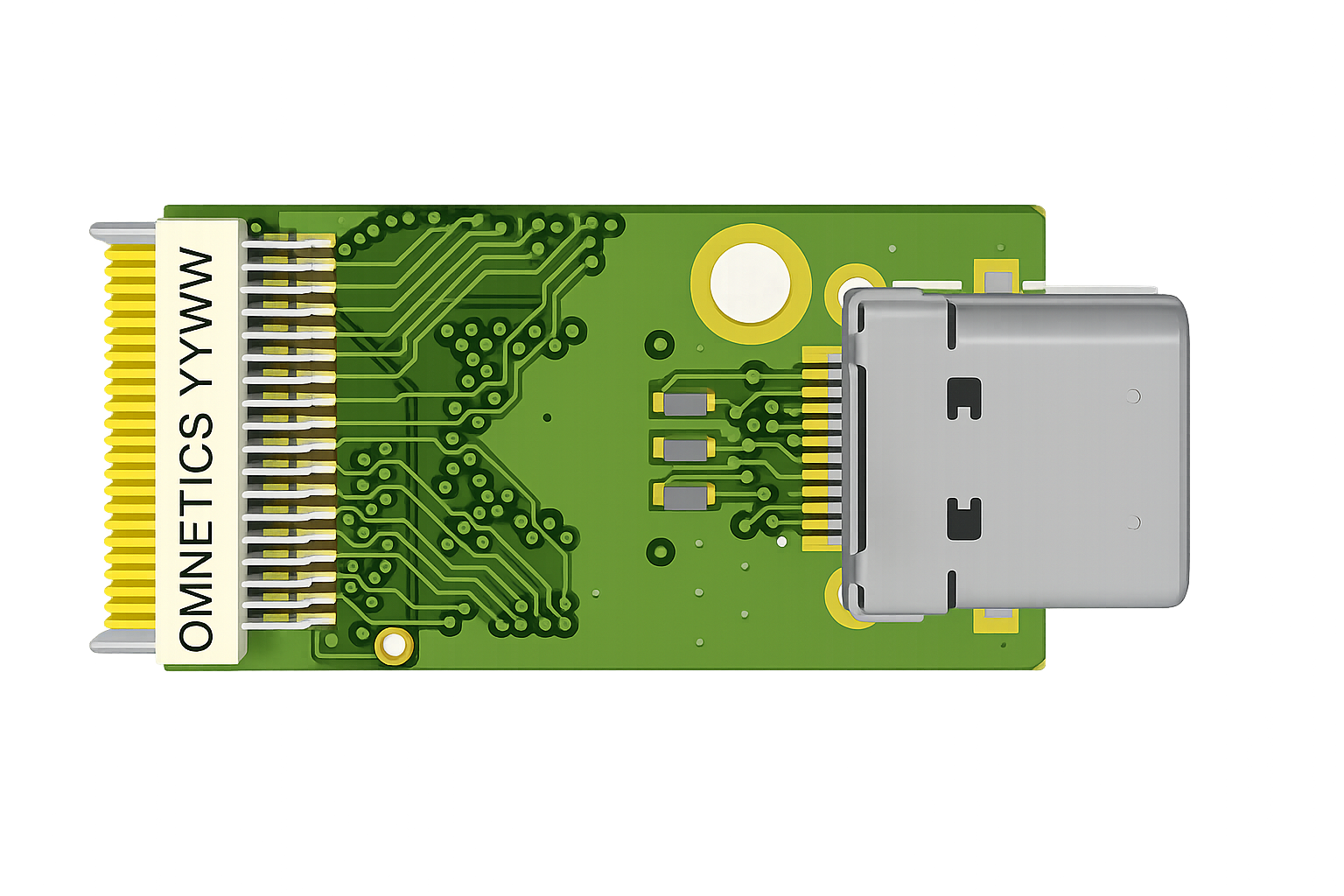
Little Visual of Setup (Old pictures)

Slide 8
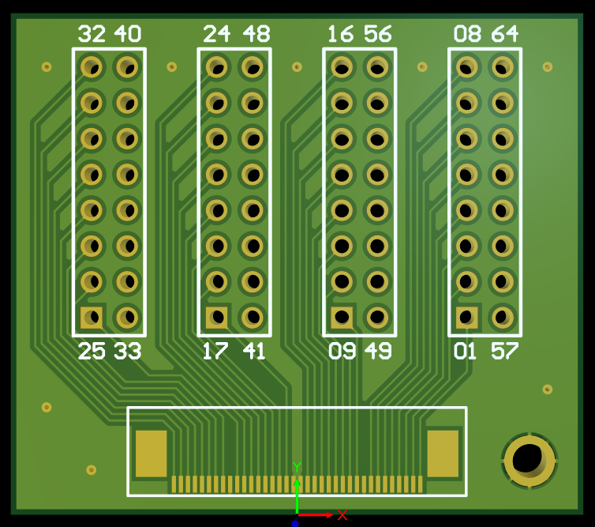
Electrode to Header Adapter

Slide 9
What next
High priority
Order everything (PCB, FPC and components)
Low priority
Prepare test plans and code

